Slide 1

Meet the Teacher
September 2025
Porpoise Class

Slide 2
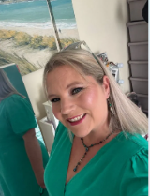
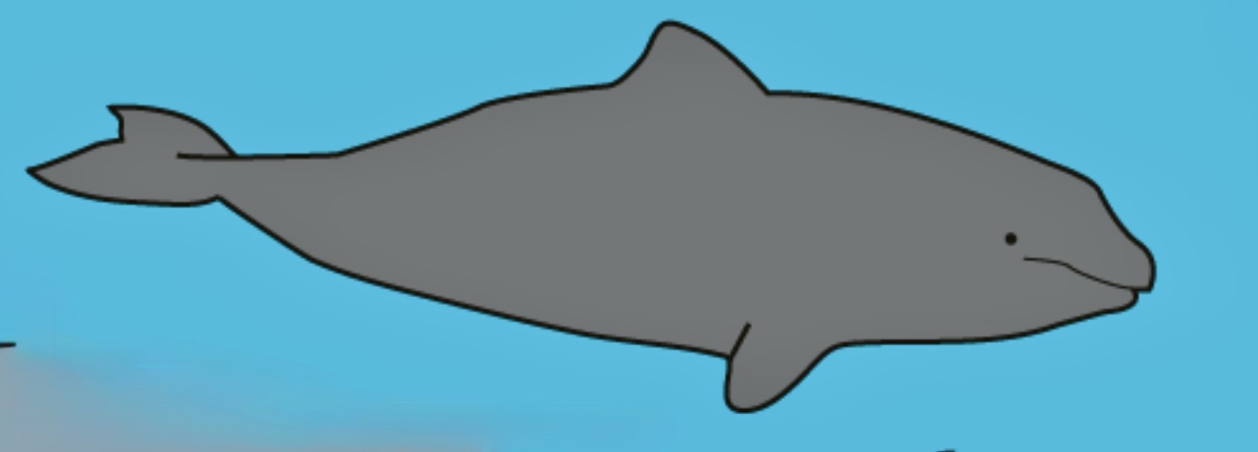
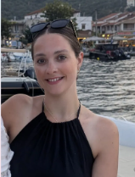
Welcome to Porpoise Class
Ms Wall
Miss Palmer

Slide 3
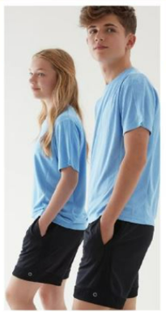
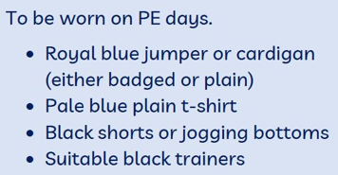


Our PE Days are Monday and Tuesday
.

Slide 4
Snacks and drinks
Healthy snacks – fruit, vegetables, crackers
Water bottles
Coats – essential!

Slide 5
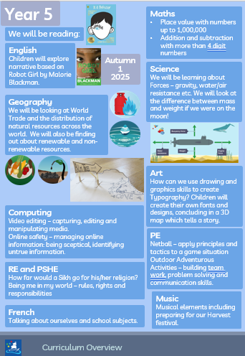
What we will be learning this half term:
Notes:
You will be sent one of these each half term.

Slide 6

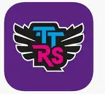
Homework Expectations
Please make sure your child is regularly reading at home and that they are spending time practising their times tables on TTRS.
Notes:
If parents ask about White Rose books – just say 'not at the moment', we are asking children to read as the priority at the moment and practise their multiplication facts.

Slide 7
Year group specifics
E.g. Y6 SATs
Y1 PSC
YR baseline
Y4 MTC

Slide 8
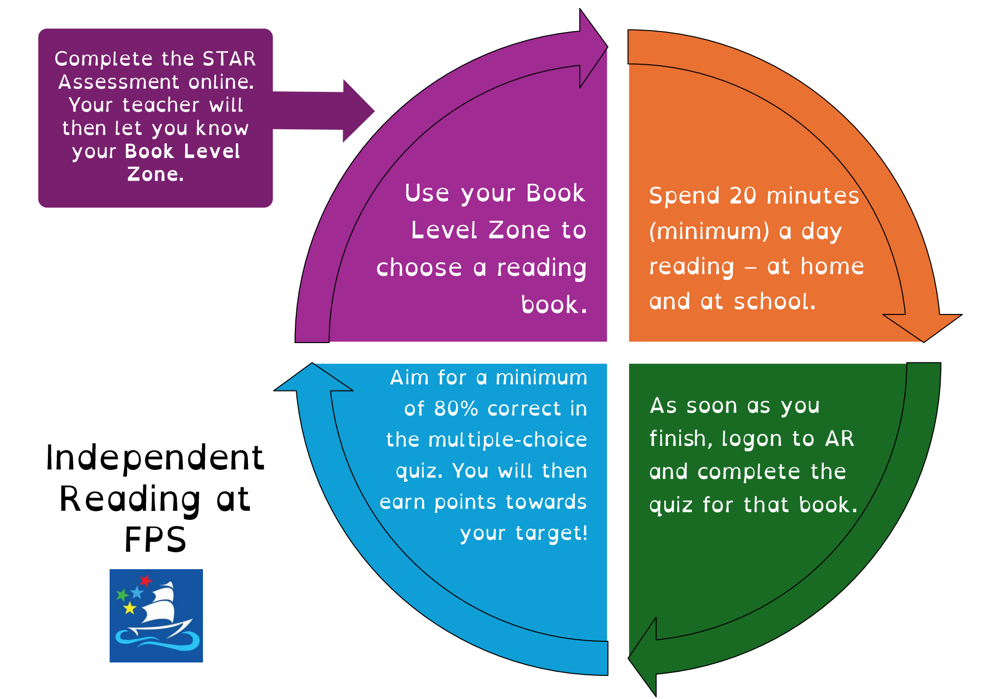

Slide 9
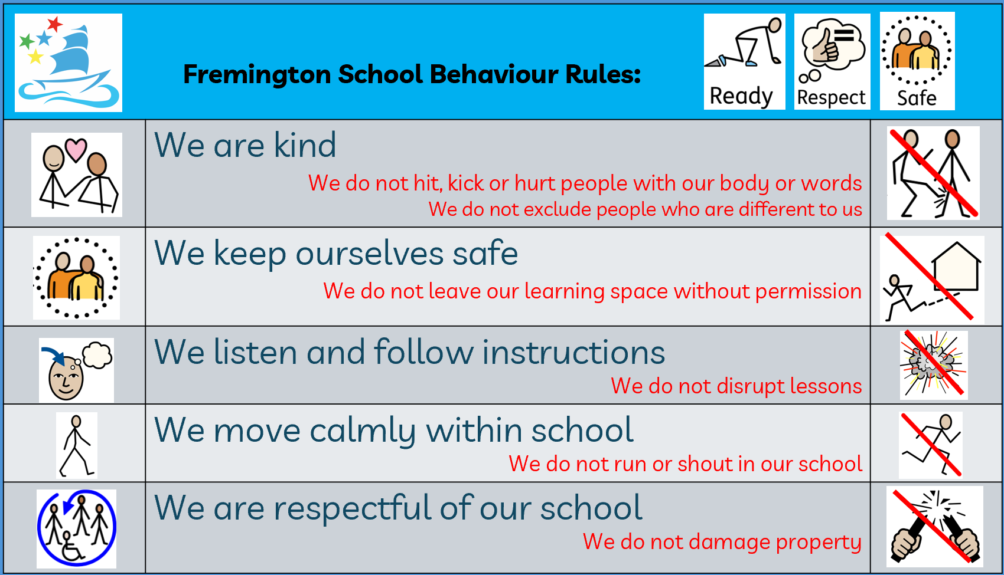
Behaviour Expectations

Slide 10
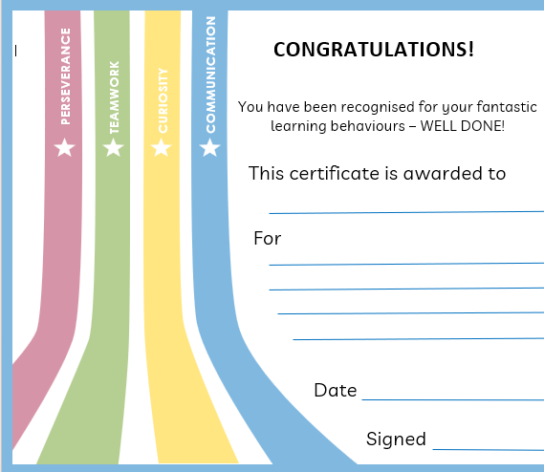
Learning Powers

Slide 11
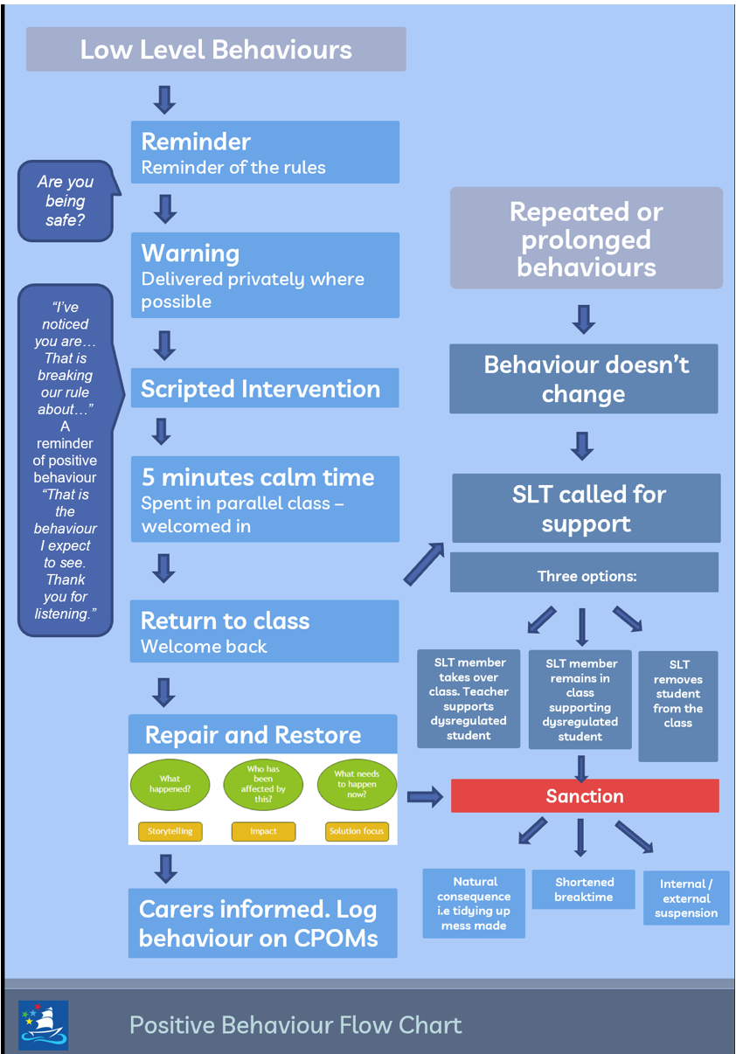
Positive behaviour

Slide 12
Contact details
Contact me with questions or any concerns at
fremington@thsp.org.uk
During the day if you have an urgent message, please call the admin team.
Notes:
Class email will be up and running soon

Slide 13

Communication
Class Dojo will be in place for all classes.
The purpose of Class Dojo will be for teachers to...
Celebrate pupil achievements
Share learning highlights
Communicate reminders
Strengthen partnerships
With the exception on the EYFS classes, Class Dojo will not be a messaging tool. It will be a one-way sharing platform.
If parents wish to contact the teacher, they should call the office or email fremington@thsp.or.uk.
Class emails will be up and running shortly – there has been a delay with our IT provider.

