Slide 1

Meet the Teacher
September 2025
Badger Class

Slide 2
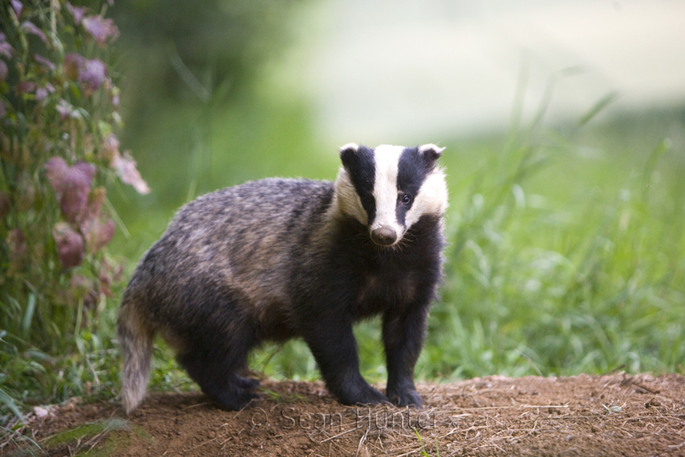
Welcome to Badger Class
Miss Turner
Mrs Lycett
Mrs Buckingham
Mrs Coley

Slide 3
Classroom Routines
Children keep their drinks in trays and can access them throughout the day – please make sure this is just water.
At breaktime (10:45am), children can have a snack of fruit.
Children don’t need to bring in any stationery from home – we have everything they will need in school.
If your child needs to bring a phone to school, please email fremington@thsp.org.uk
If you would like your child to walk home on their own, please complete the form sent out last week.
Healthy snacks – fruit, vegetables, crackers​
Water bottles​
Coats – essential!

Slide 4

Nut Free School
We have several children with serious nut allergies which are potentially life threatening.
It is vital for these children that nuts are not brought into school as an allergic reaction may be caused by a child touching a surface which has been touched by a child with traces of nuts on their hands
Please check the nutritional labels of the foods you are sending in for snacks and lunch.

Slide 5
SATs
SATs week in 2026 is scheduled for Monday, May 11 to Thursday, May 14, 2026.
Children will sit grammar + spelling, reading and maths papers over the 4 days
The tests help measure students' progress and provide valuable information for parents and teachers.
The results of the assessments will be shared with parents and children in July.
Notes:
We’ll give you more info closer to the time and do lots of prep work with children to ensure they are ready

Slide 6
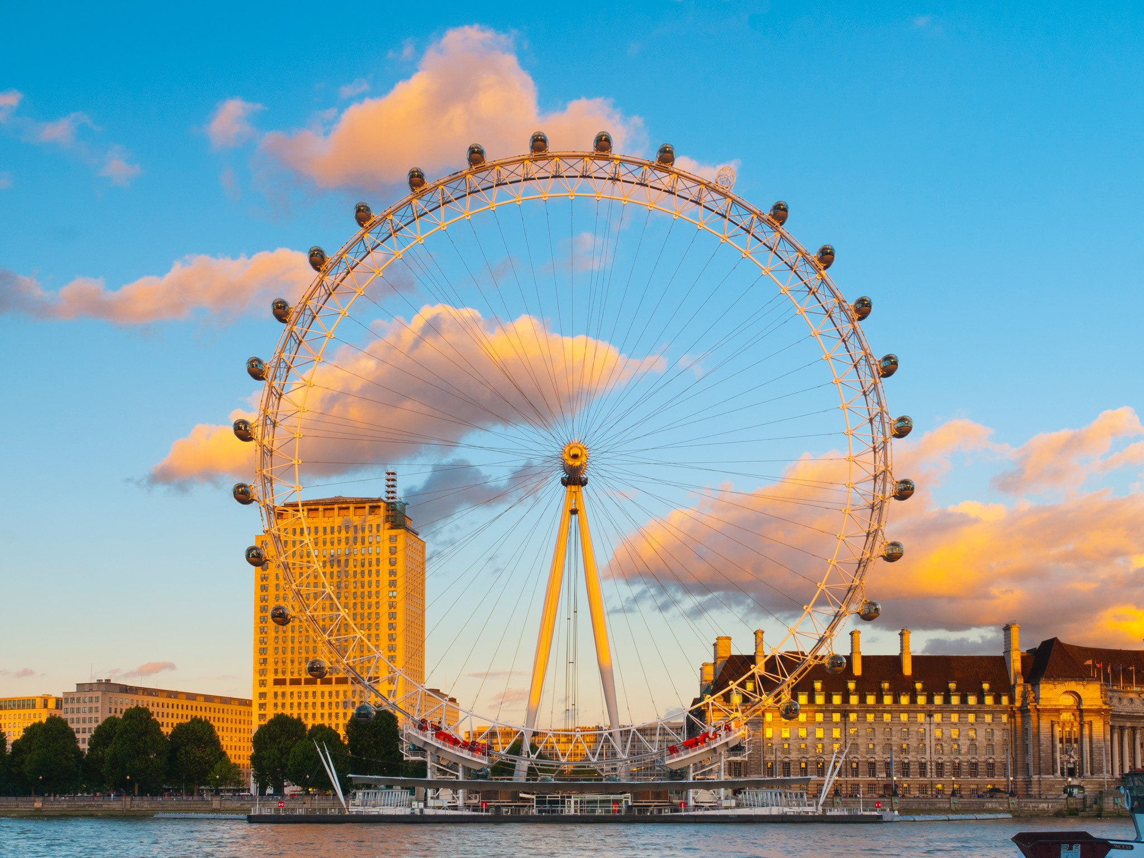
London Residential
Thank you for those who have registered an interest in the London residential (a form was emailed home last year). We have had a positive indication and within the next few weeks, information will come home about the cost, deadlines for payments and the planned itinerary. It will follow a very similar structure to last year:
Activities: Museums, London Eye, River boat cruise, Tower of London, West End Show, Harry Potter studios.
Date: June/July.
Accommodation: We will probably stay in a Youth Hostel again
We will be taking many familiar school adults. We will be clearer on
details once final numbers are agreed.

Slide 7

Communication
Class Dojo will be in place for all classes.
The purpose of Class Dojo will be for teachers to...
Celebrate pupil achievements
Share learning highlights
Communicate reminders
Strengthen partnerships
With the exception on the EYFS classes, Class Dojo will not be a messaging tool. It will be a one-way sharing platform.
If parents wish to contact the teacher, they should call the office or email fremington@thsp.org.uk.
Class emails will be up and running shortly – there has been a delay with our IT provider.

Slide 8

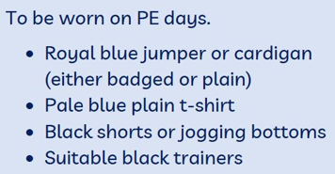
Our PE Days are Wednesday and Thursday
.

Slide 9

Uniform Expectations

Slide 10
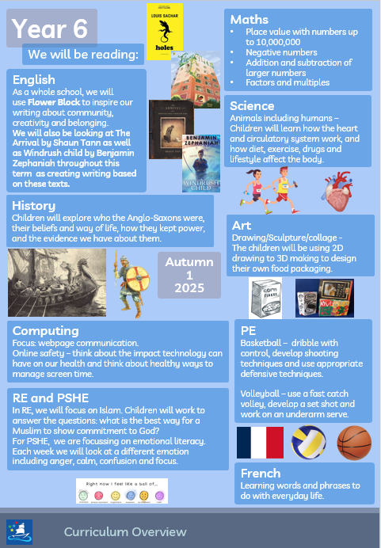
What we will be learning this half term:

Slide 11


Homework Expectations
Please make sure your child is regularly reading at home and that they are spending time practising their times tables on TTRS.

Slide 12
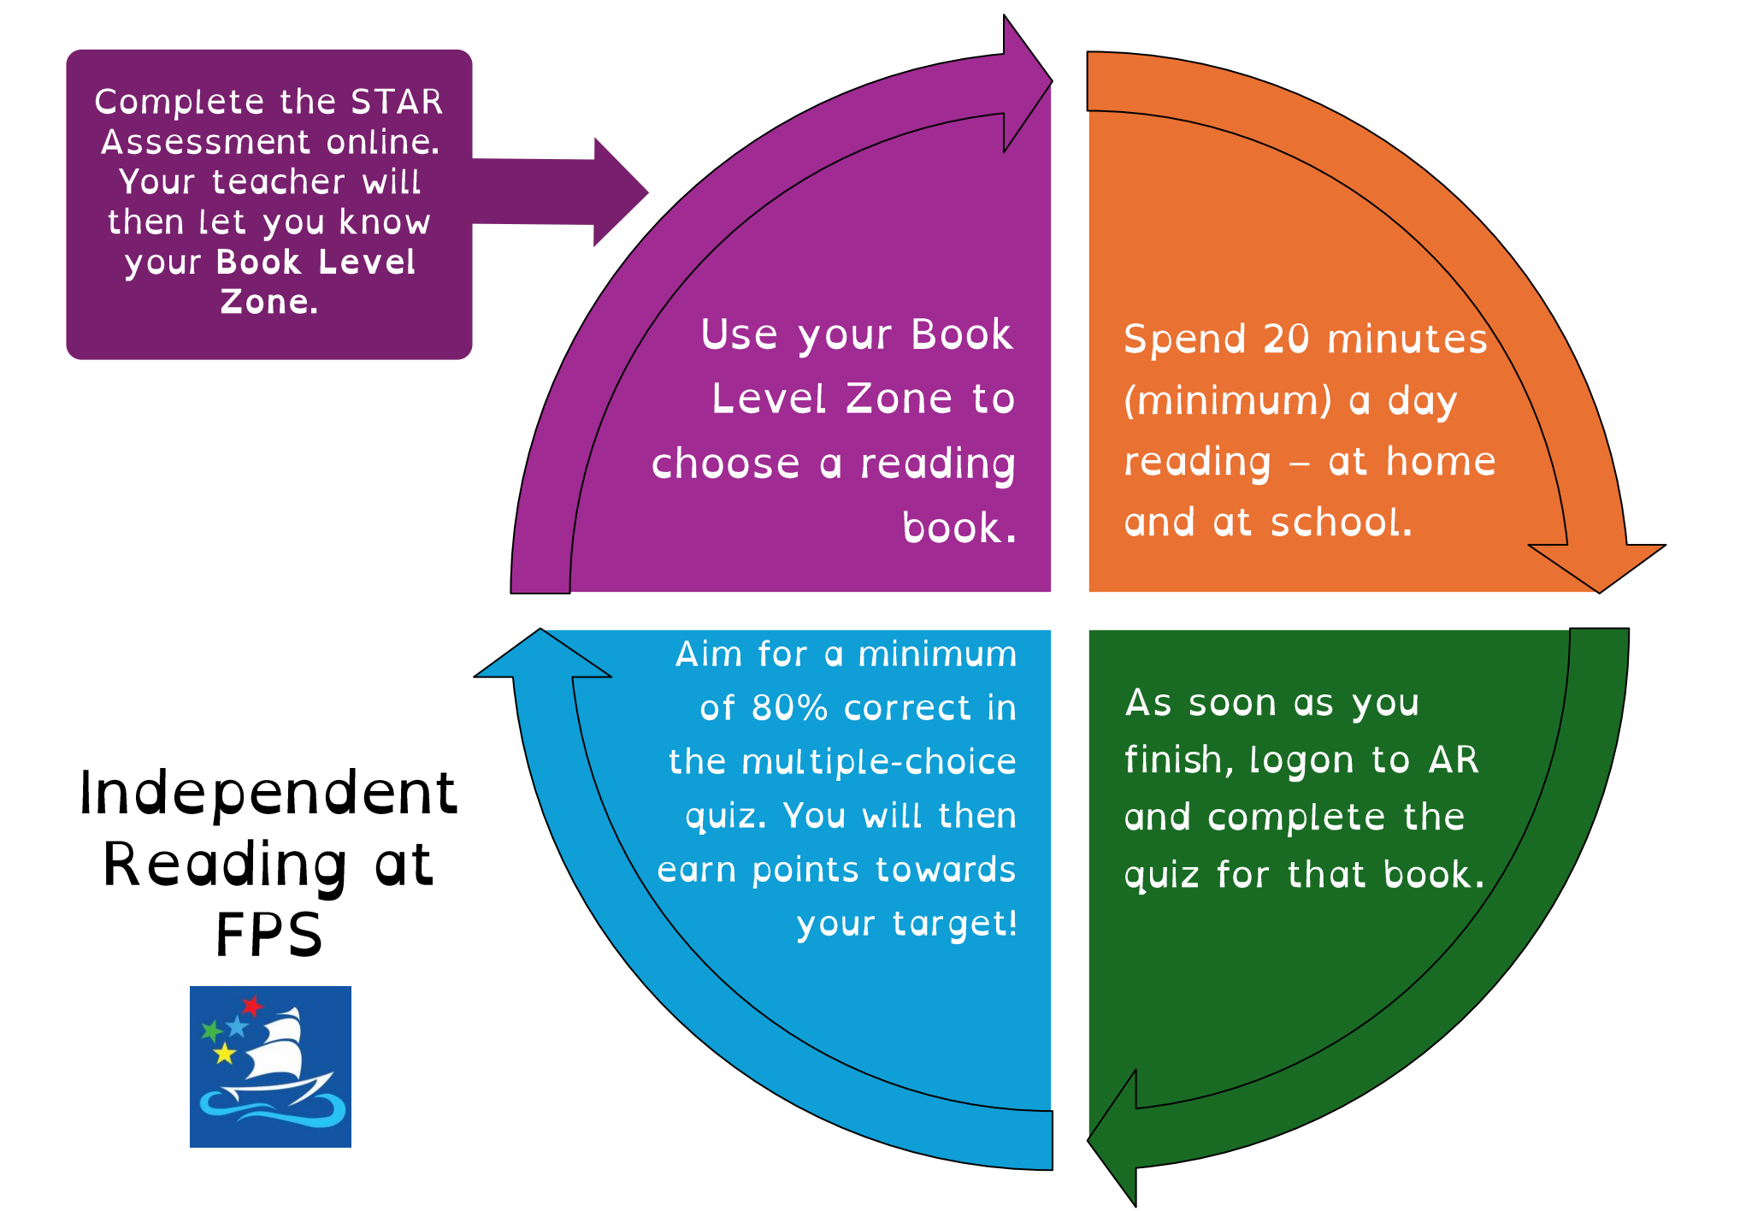

Slide 13
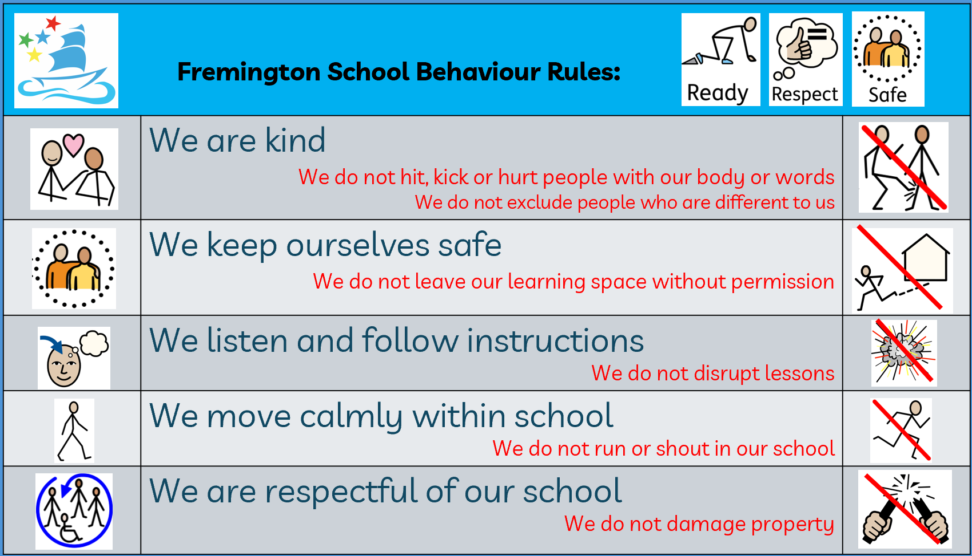
Behaviour Expectations

Slide 14
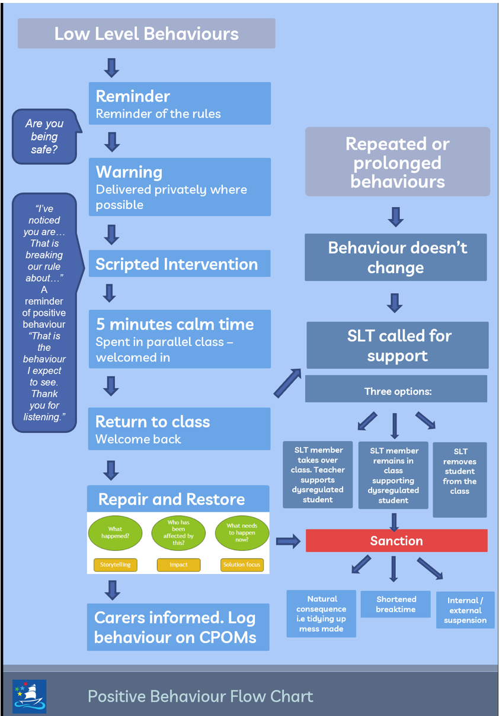
Positive behaviour

Slide 15
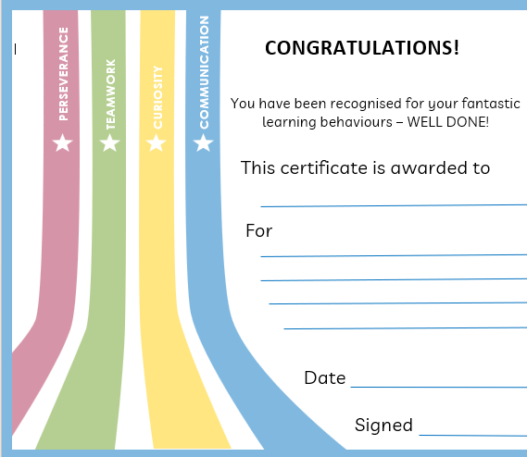
Learning Powers

